Slide 1
Lecture 2
Algorithm Analysis
Arne Kutzner
Hanyang University / Seoul Korea

Slide 2
Overview
2 algorithms for sorting of numbers are presented
Divide-and-Conquer strategy
Growth of functions / asymptotic notation
Algorithm Analysis
L1.<number>

Slide 3
Sorting of Numbers
Input
A sequence of n numbers [a₁, a₂,..., a_{n}]
Output
A permutation (reordering)
[a’₁, a’₂,..., a’_{n}] of the input sequence such that a’₁≤ a’₂ ≤... ≤ a’_{n}
Algorithm Analysis
L1.<number>

Slide 4
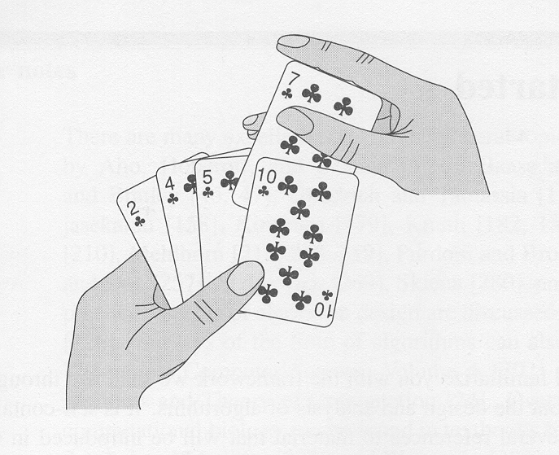
Sorting a hand of cards
Algorithm Analysis
L1.<number>

Slide 5
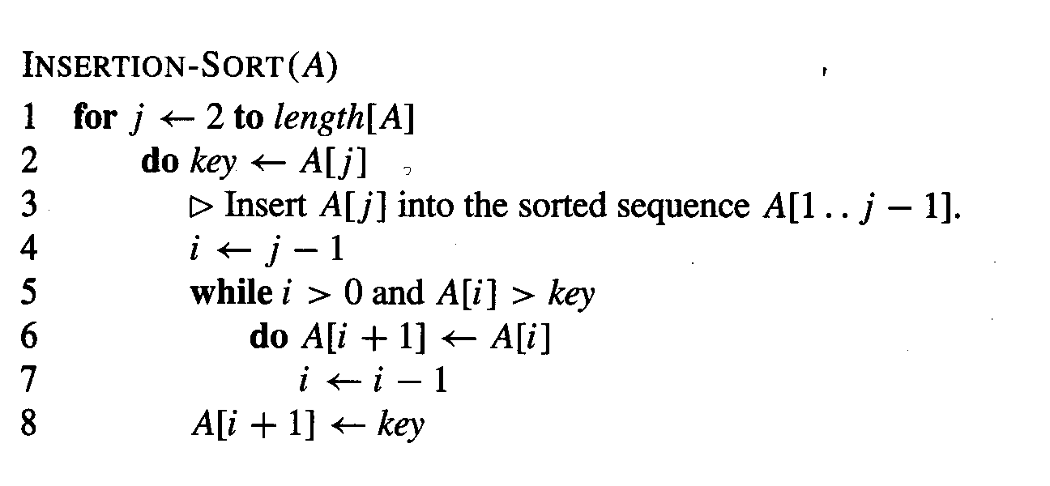
The insertion sort algorithm
Algorithm Analysis
L1.<number>

Slide 6
Correctness of insertion sort
Loop invariants – for proving that some algorithm is correct
Three things must be showed about a loop invariant:
  Initialization: It is true prior to the first iteration of the loop
  Maintenance: If it is true before an iteration of the loop, it remains true before the next iteration
  Termination: When the loop terminates, the invariant gives us a useful property that helps show that the algorithm is correct
Algorithm Analysis
L1.<number>

Slide 7
Loop invariant of insertion sort
At the start of each iteration of the for loop of lines 1-8, the subarray A[1..j-1] consists of the elements originally in A[1..j-1] but in sorted order
Algorithm Analysis
L1.<number>

Slide 8
Analysing algorithms
Input size = number of items (numbers) to be sorted
We count the number of comparisons
Algorithm Analysis
L1.<number>

Slide 9
Insertion sort / best-case
In the best-case (the input sequence is already sorted) insertion sort requires
n-1 comparisons
Algorithm Analysis
L1.<number>

Slide 10
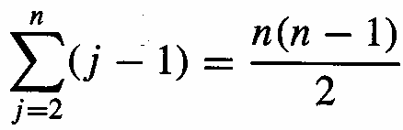
Insertion sort / worst-case
The input sequence is in reverse sorted order
We need
comparisons
Algorithm Analysis
L1.<number>

Slide 11
Worst-case vs. average case
Worst-case running time of an algorithm is an upper bound on the running time for any input
For some algorithms, the worst case occurs fairly often.
The „average case“ is often roughly as bad as the worst case.
Algorithm Analysis
L1.<number>

Slide 12
Growth of Functions
Asymptotic Notation and
Complexity

Slide 13
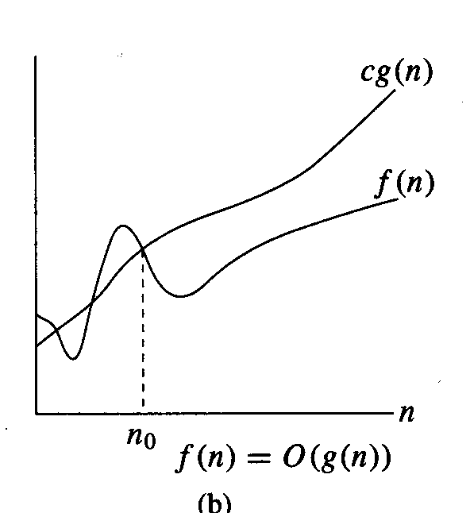
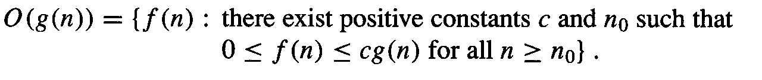
Asymptotic upper bound
Algorithm Analysis
L1.<number>

Slide 14
Asymptotic upper bound (cont.)
Example of application:
Description of what is the required number of operations of some algorithm in worst case situations.
E.g. O(n²) , where n is the size of the input
  O(n²) means the algorithm has a “square behavior” in the worst case. The O-notation allows us to hide scalars/constants involved in the complexity description.
Algorithm Analysis
L1.<number>

Slide 15
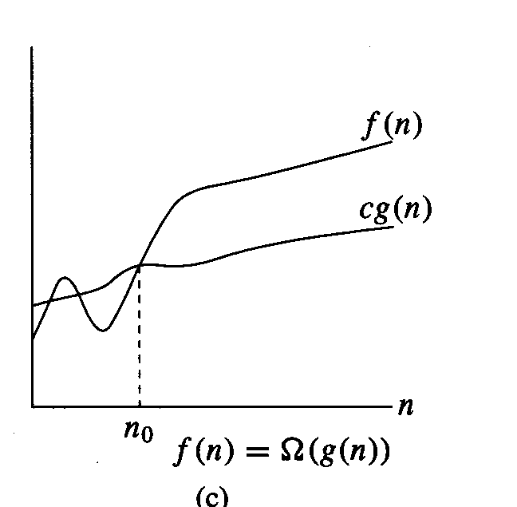
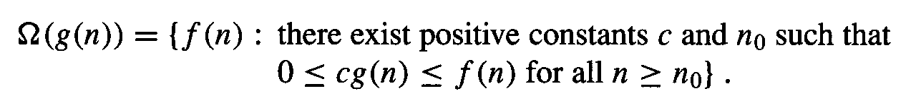
Asymptotic lower bound
Algorithm Analysis
L1.<number>

Slide 16
Asymptotic lower bound (cont.)
Examples of application:
Description of what is the required number of operations of some algorithm in best case situations.
E.g. Ω(n), where n is the size of the input
  Ω(n) means the algorithm has “linear behavior” in the best case. (The algorithm can still be O(n²) in worst case situations!)
Description of what is the required number of operations in the worst case for any algorithm that solves some specific problem.
Example: The required number of comparisons of any sorting algorithm in the algorithm’s worst case. (The worst case can be different for different algorithms that solve the same problem.)
Algorithm Analysis
L1.<number>

Slide 17
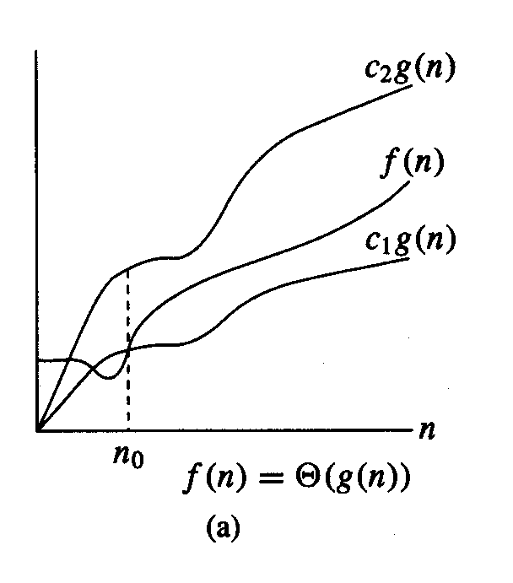
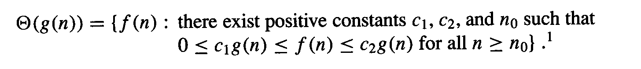
Asymptotically tight bound
Algorithm Analysis
L1.<number>

Slide 18
Asymptotic tight bound (cont.)
Example of application:
Simultaneous worst case and best case statement for some algorithm:
E.g. θ(n²) expresses that some algorithm A shows a square behavior in the best case (A requires at least Ω(n²) many operations for all inputs) and at the same time it expresses that A will never need more than “square many” operations (the effort is limited by O(n²) many operations).
Algorithm Analysis
L1.<number>

Slide 19
Complexity of an algorithm
Complexity expresses the counting of performed operations of an algorithm with respect to the size of the input:
  We can count only a single type of operations, e.g. the number of performed comparisons.
  We can count all operations performed by some algorithm. This complexity is called time complexity.
Complexity may be (normally is) expressed by using asymptotic notation.
Algorithm Analysis
L1.<number>

Slide 20
Exercises
With respect to the number of performed comparisons:
  What is the asymptotic upper bound of Insertion Sort ?
  What is the asymptotic lower bound of Insertion Sort ?
  Is there any asymptotically tight bound of Insertion Sort?
    If yes: What is the asymptotically tight bound?
    If no: Why is there no asymptotically tight bound?
If we move from counting comparisons to the more general time complexity, then are there any differences with respect to the three bounds?
Algorithm Analysis
L1.<number>

Slide 21
Merge-Sort Algorithm

Slide 22
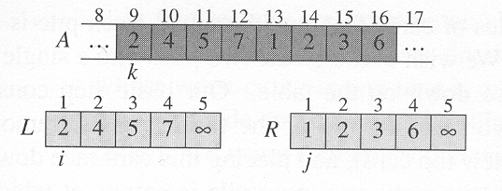
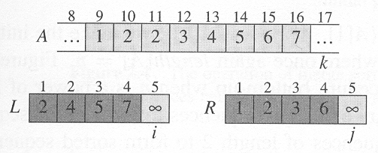
Example merge procedure
Algorithm Analysis
L1.<number>

Slide 23
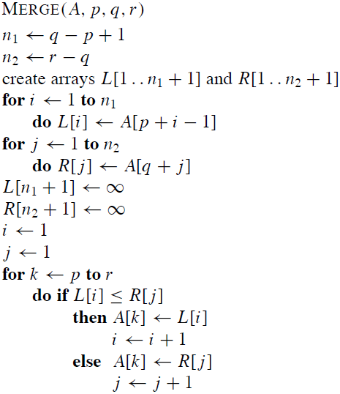
Merge procedure
Algorithm Analysis
L1.<number>

Slide 24
Merging – Complexity for symmetrically sized inputs
Symmetrically sized inputs (n/2, n/2)
(here 2 times 4 elements)
  We compare 6 with all 5 and 8
  (4 comparisons)
  We compare 8 with all 7 (3 comparisons)
Generalized for n elements:
  Worst case requires n – 1 comparisons
  Exercise: Best case?
  Time complexity cn = Θ(n).
6
7
7
7
5
5
5
8
Algorithm Analysis
L1.<number>

Slide 25
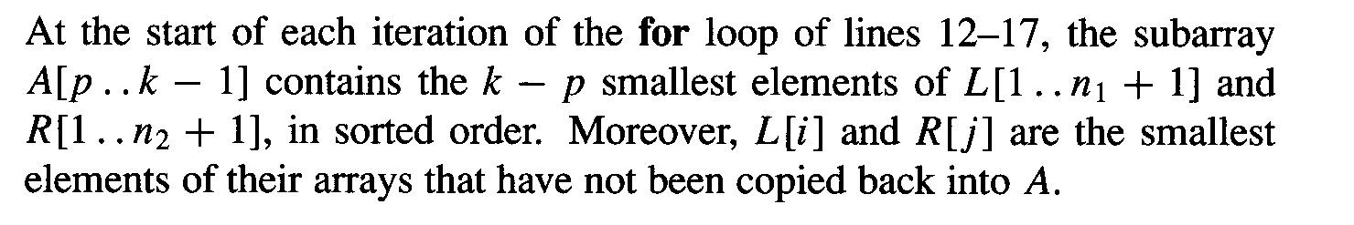
Correctness merge procedure
Loop invariant:
Algorithm Analysis
L1.<number>

Slide 26
The divide-and-conquer approach
Divide the problem into a number of subproblems.
Conquer the subproblems by solving them recursively. If the subproblem sizes are small enough, however, just solve the subproblems in straightforward manner.
Combine the solutions to the subproblems into the solution for the original problem
Algorithm Analysis
L1.<number>

Slide 27
Merge-sort algorithm
Divide: Divide the n-element sequence to be sorted into two subsequences of n/2 elements each.
Conquer: Sort the two subsequences recursively using merge sort.
Combine: Merge the two sorted subsequences to produce the sorted answer.
Algorithm Analysis
L1.<number>

Slide 28
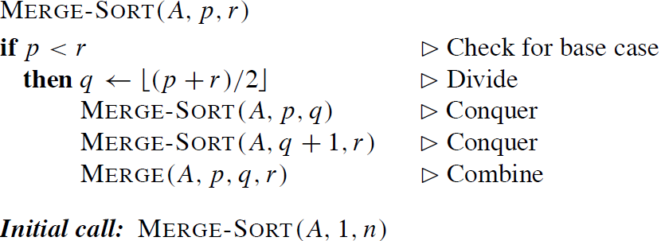
Merge-sort algorithm
Algorithm Analysis
L1.<number>

Slide 29
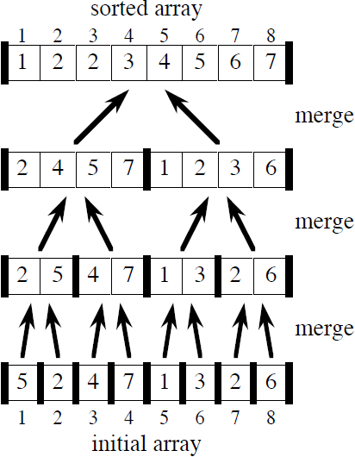
Example merge sort
Algorithm Analysis
L1.<number>

Slide 30
Analysis of Mergesort regarding Comparisons
When n ≥ 2, for mergesort steps:
  Divide: Just compute q as the average of p and r ⇒ no comparisons
  Conquer: Recursively solve 2 subproblems, each of size n/2⇒2T (n/2).
  Combine: MERGE on an n-element subarray requires cn comparisons ⇒ cn = Θ(n).
Algorithm Analysis
L1.<number>

Slide 31
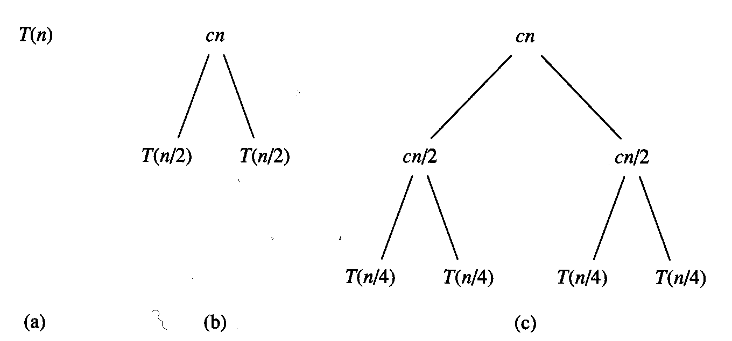
Analysis merge sort 2
Algorithm Analysis
L1.<number>

Slide 32
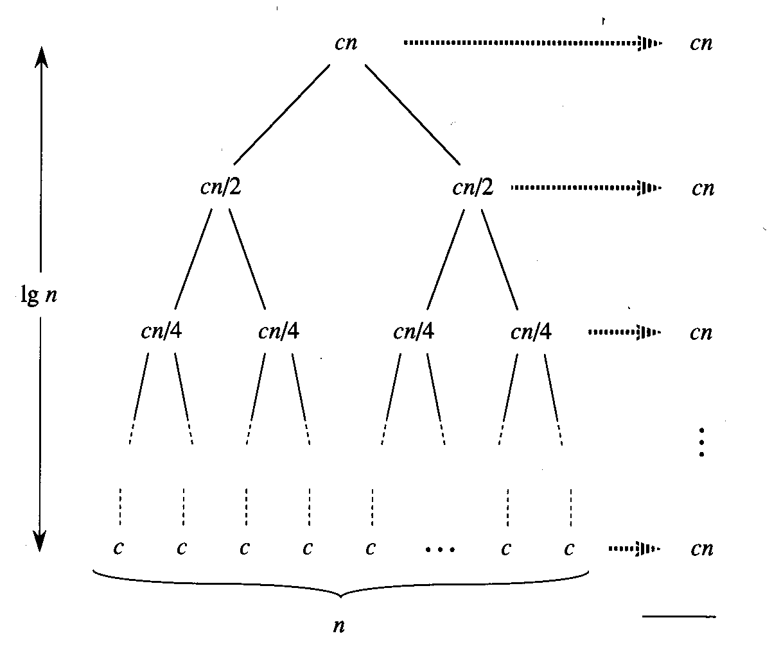
Analysis merge sort 3
Algorithm Analysis
L1.<number>

Slide 33
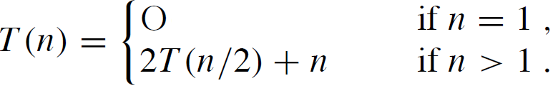
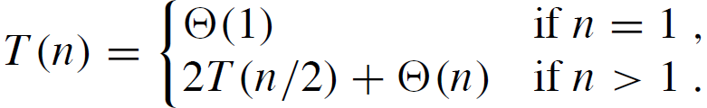

Mergesort recurrences
Recurrence regarding comparisons (worst case)
Recurrence time complexity:
Both recurrences can be solved using the master-theorem:
C
C
-1
Algorithm Analysis
L1.<number>

Slide 34
Lower Bound for Sorting
Is there some lower bound for the time complexity / number of comparisons with sorting?
Answer: Yes!
Ω(n log n)
where n is the size of the input
Later more about this topic ……
Algorithm Analysis
L1.<number>

Slide 35
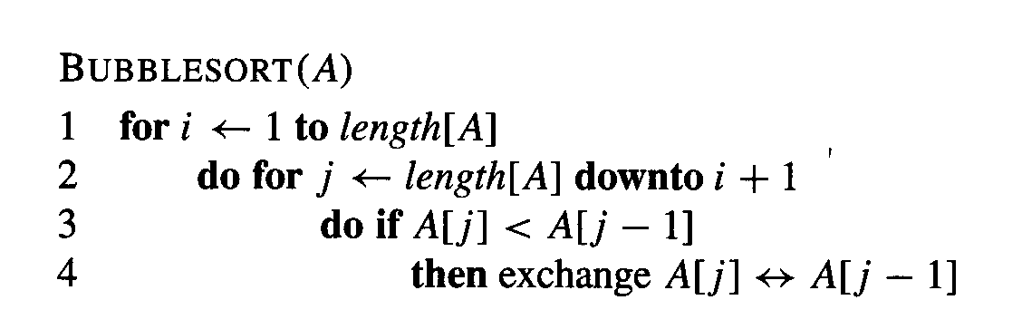
Bubblesort
Further popular sorting algorithm
Algorithm Analysis
L1.<number>

